Slide 1
The real world benefits of Sophos XDR
Vu Le
Security Solutions Engineer
Duc Pham (Mikel)
Security Solutions Consultant - CISSP

Slide 2
Nội dung
Xu hướng bảo vệ máy trạm trong năm 2022
Giới thiệu Sophos XDR và hệ sinh thái Sophos ACE
Q&A
MiniGame

Slide 3
Xu hướng của các giải pháp bảo vệ máy trạm?

Slide 4
NIST Cyber Security Framework
Identify
Protect
Detect
Respond
Recover
Develop an organizational understanding to manage cybersecurity risk to systems, people, assets, data and capabilities
Develop and implement the appropriate activities to maintain plans for resilience and to restore any capabilities or services that were impaired due to a cybersecurity event.
Develop and implement the appropriate safeguards to ensure delivery of critical infrastructure services.
Develop and implement the appropriate activities to identify the occurrence of a cybersecurity event.
Develop and implement the appropriate activities to take action regarding a detected cybersecurity event.

Slide 5
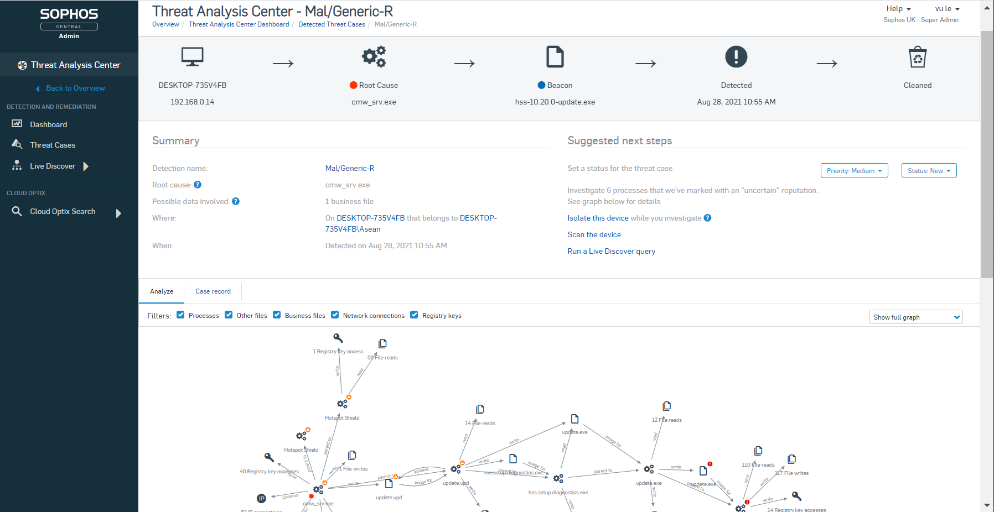




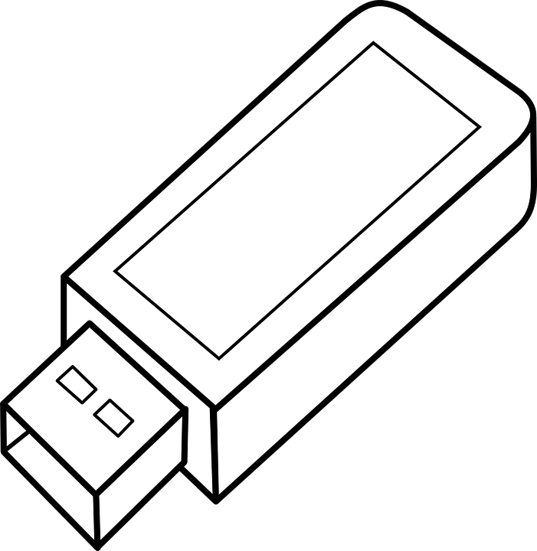
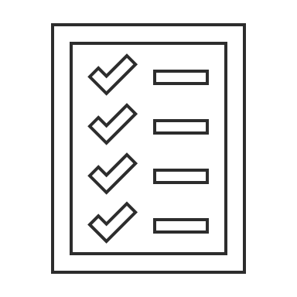



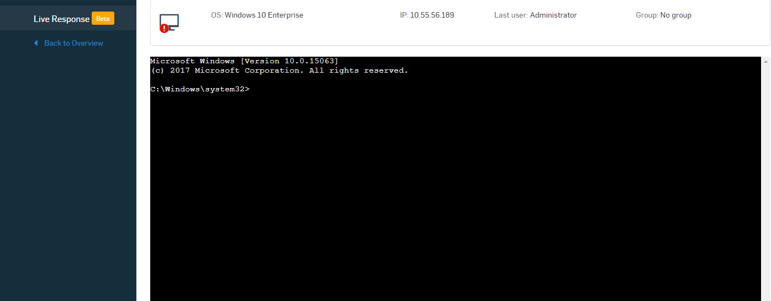



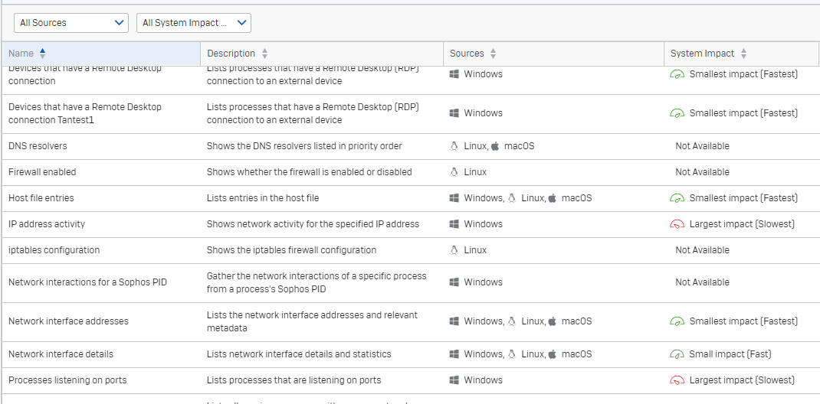
Sophos Next Generation Endpoint Protection
    Web Control
    Application Control
Anti Malware,
Traditional Protection
    Peripheral Control
    Data Loss Prevention
Plus
    Deep Learning A.I.
    CryptoGuard
Next Generation
Endpoint Protection
    Anti-Exploit
    ATP, Zero day attack
Plus
    Root Cause Analysis
    Live Discover
Endpoint Detection
& Response
    Live Response

Slide 6

XDR Extends Detection and Response Beyond the Endpoint
Network
Endpoint
Email
Server
Mobile*
Cloud*
Endpoint Detection and Response (EDR)
Extended Detection and Response (XDR)
*Mobile and cloud coming soon

Slide 7
More Data Sources
Network
Endpoint
Email
0365
Server
Mobile
Cloud
Extended Detection and Response (XDR)

Slide 8
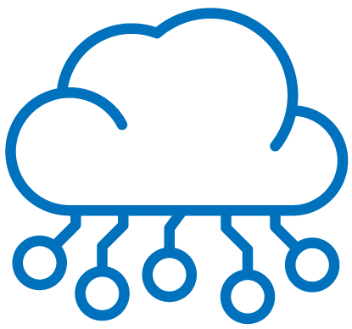

Never miss a thing: on-device and data lake telemetry
Data lake
30 days of cross-product data
Correlate information across endpoints, servers, firewalls, email, and more
Access data from offline devices
Historical view, not real-time
On-device
90 days of incredibly rich endpoint and server data
Real-time and historical views of online devices
More insights and granularity than a data lake can provide alone
Remotely access the device and take remedial actions

Slide 9
Có bao nhiêu cách xây dựng kiến trúc XDR?

Slide 10
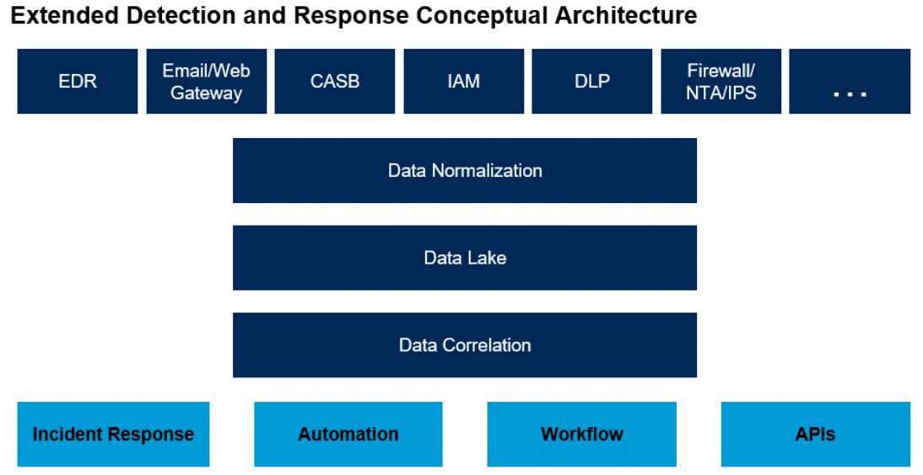

03 Primary Requirements of XDR [Gartner: Innovation Insight for XDR, 2020]
  Centralization of Normalized Data: Data Lake at large scale
  Correlation of Security Data into Incidents: Threat Case
  Centralized Incident Response capability that change the state of individual security products: built-in SOAR

Slide 11
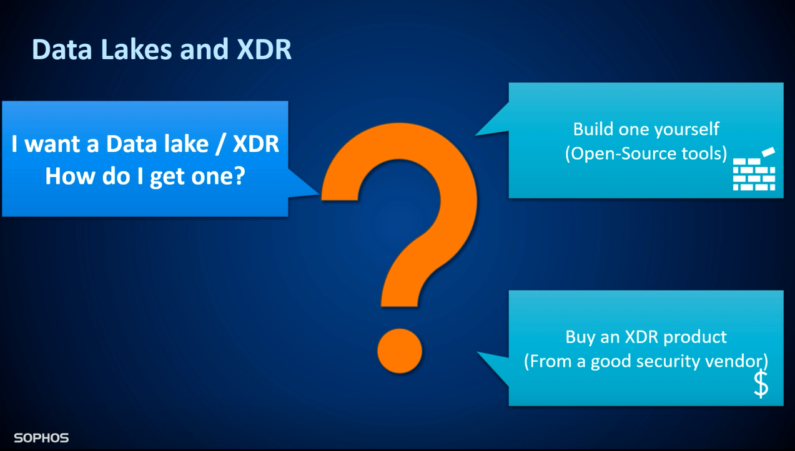

Slide 12
XDR Commercial Product
Hybrid XDR:
An XDR platform that relies on integrations with third parties for the collection of other forms of telemetry and execution of response actions related to that telemetry.
Native XDR
An XDR suite that integrates with other security tools from their portfolio for the collection of other forms of telemetry and execution of response actions related to that telemetry.
—Forrester Report “Adapt Or Die: XDR Is On A Collision Course With SIEM And SOAR”, April-2021

Slide 13
Ưu điểm của giải pháp Sophos XDR?

Slide 14
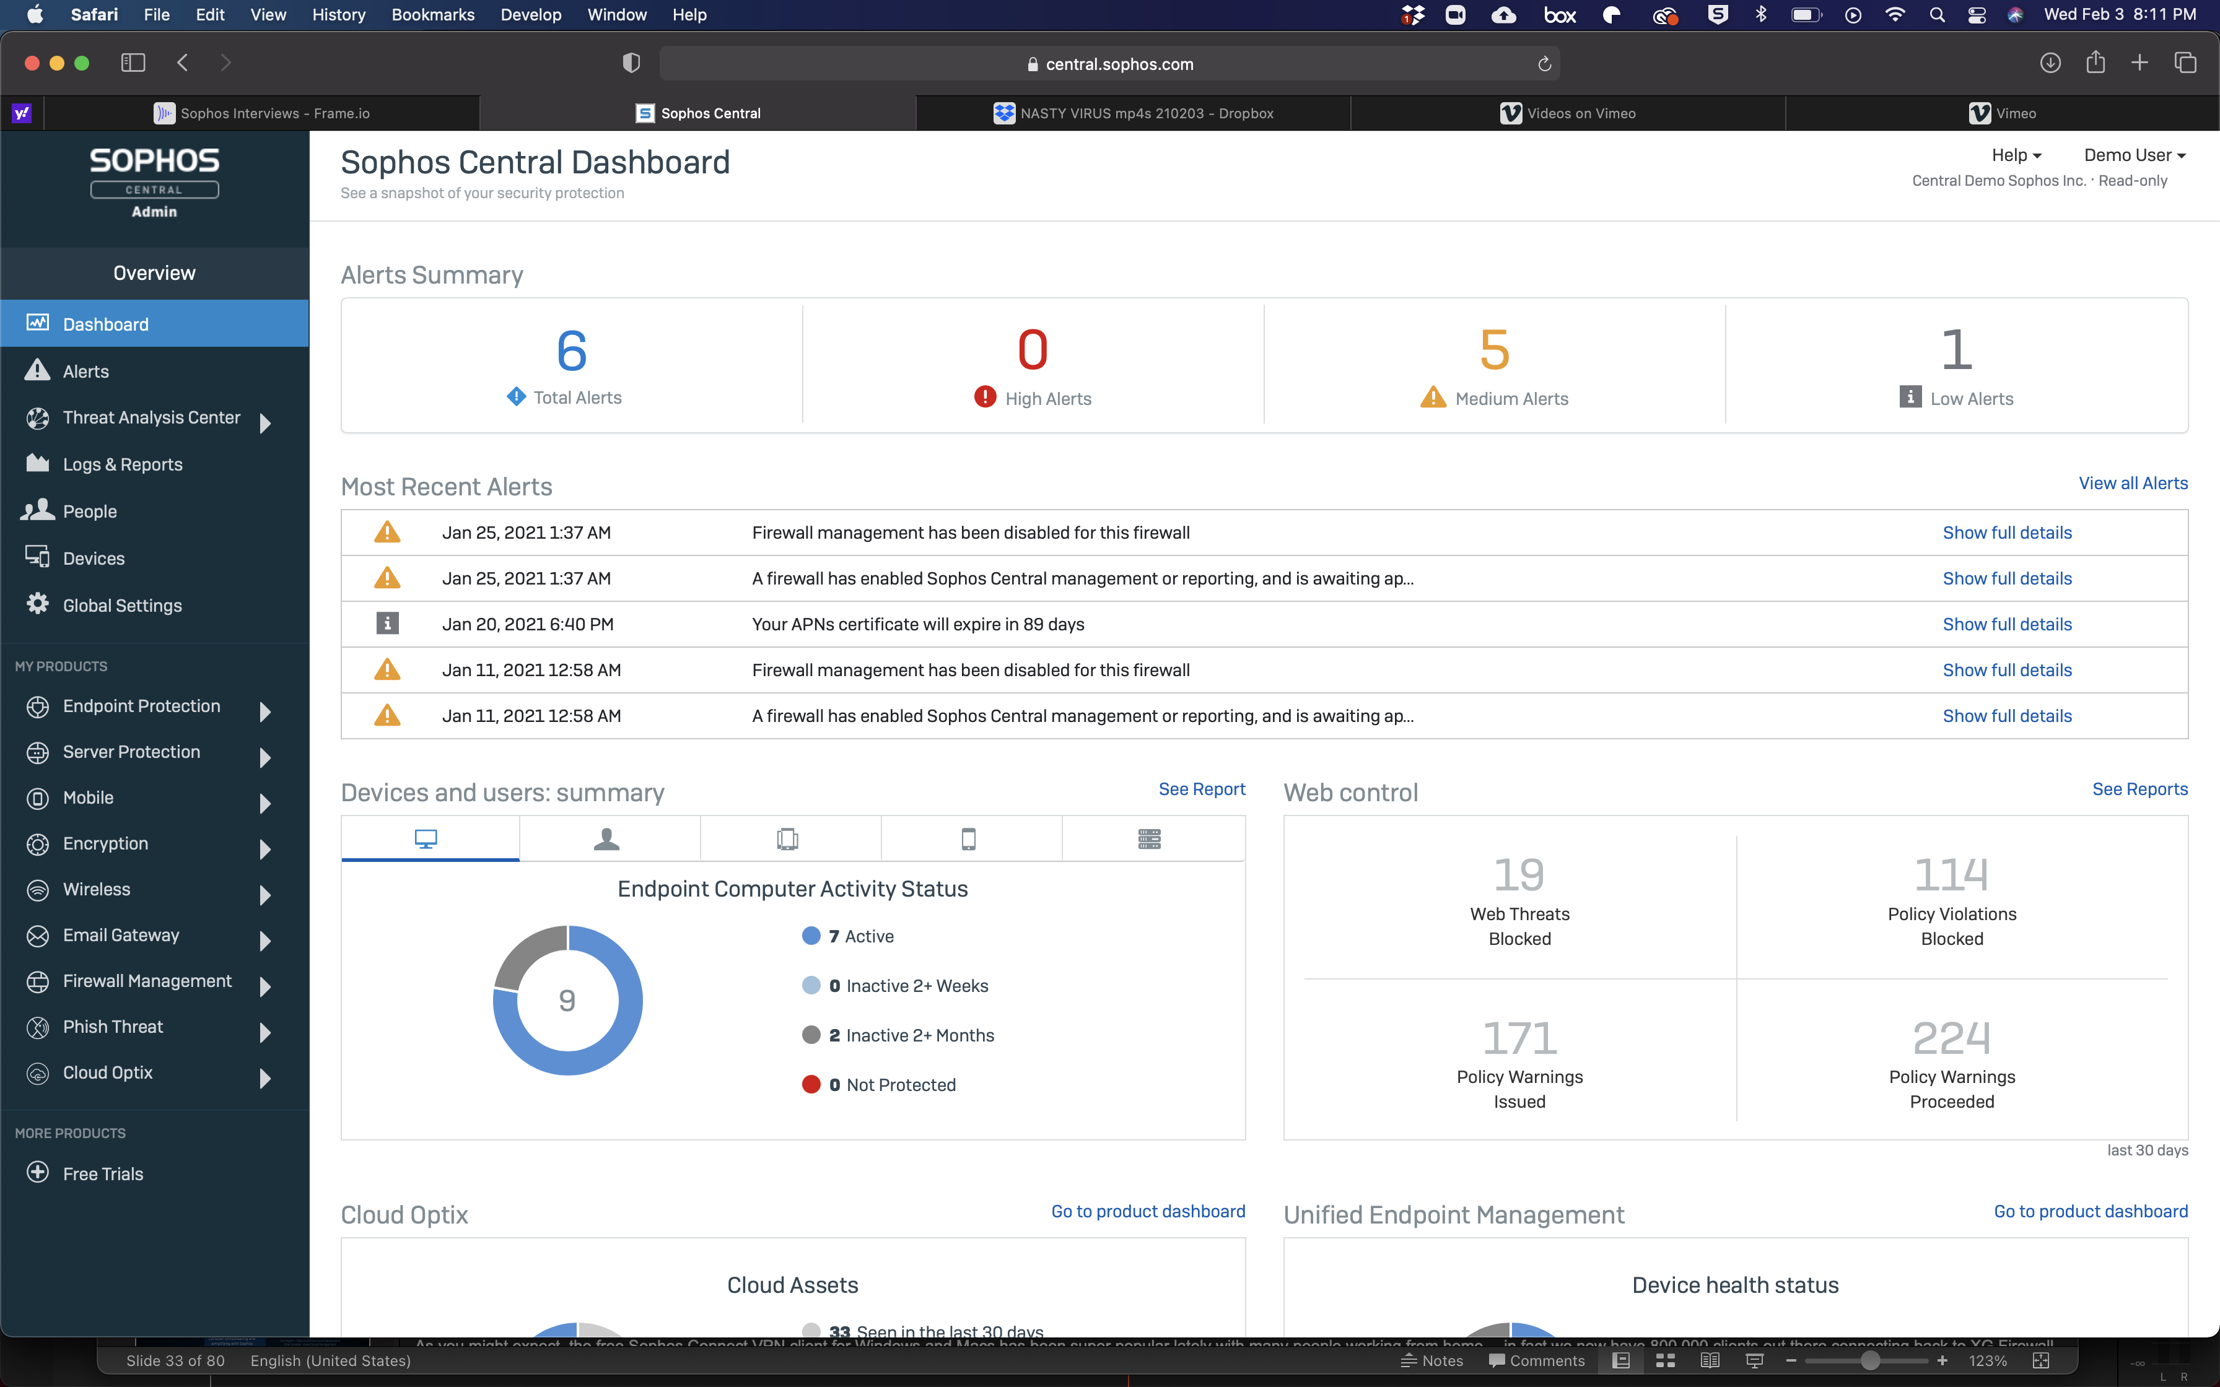

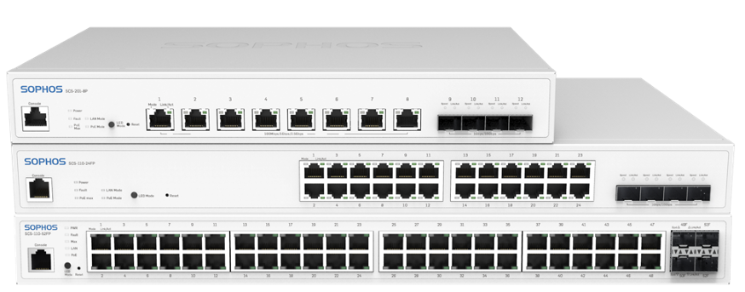
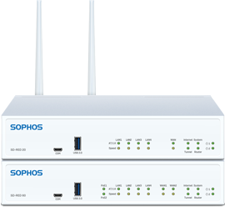



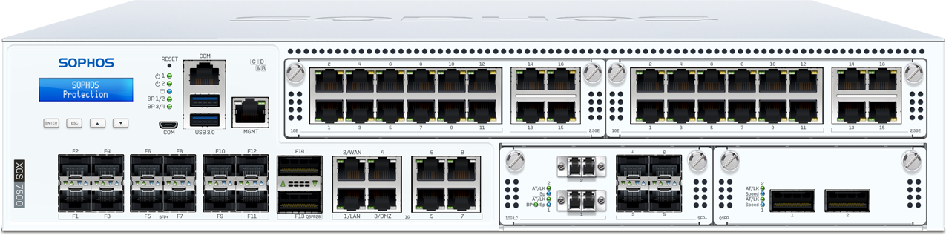


Sophos Adaptive Cybersecurity Ecosystem (ACE)
Sophos Central
Security management and SecOps threat hunting
SOFTWARE
HARDWARE
SERVICES
EDR
XDR
Endpoint
EDR
Mobile
Server
Email
Encryption
Firewall
WiFi
Cloud
Firewall
Switch
RED
AP
MTR
Rapid
Response
Professional
Services
Open APIs
THREAT INTELLIGENCE
Industry/Developer
THREAT INTELLIGENCE
Service Provider
Administrator
ARTIFICIAL INTELLIGENCE
LABS
SECURITY OPERATIONS
Security Operations
Data Lake

Slide 15
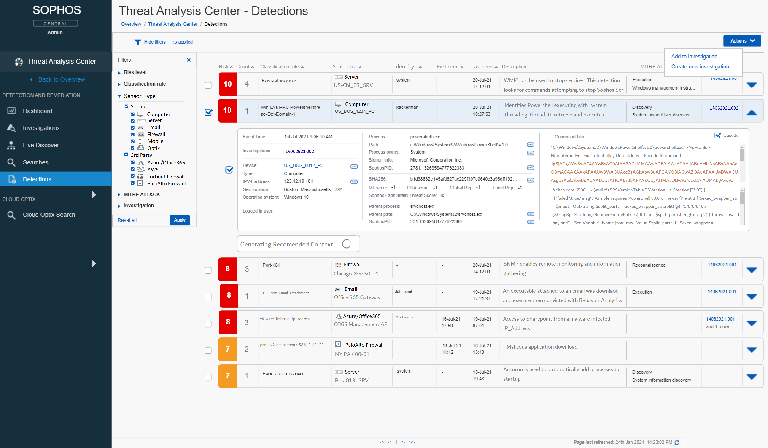
Identify and Solve Issues Faster
Detections and Investigations
Give admins the context they need
Provide detailed, tailored data
Make information actionable
Streamline collaboration

Slide 16
So sánh XDR và SIEM?

Slide 17
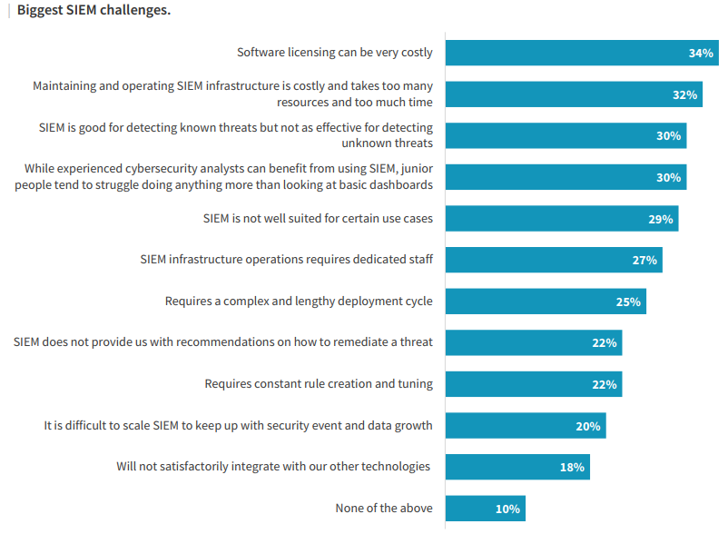

—ESG research on The Impact of XDR in the Modern SOC, Nov-2020

Slide 18

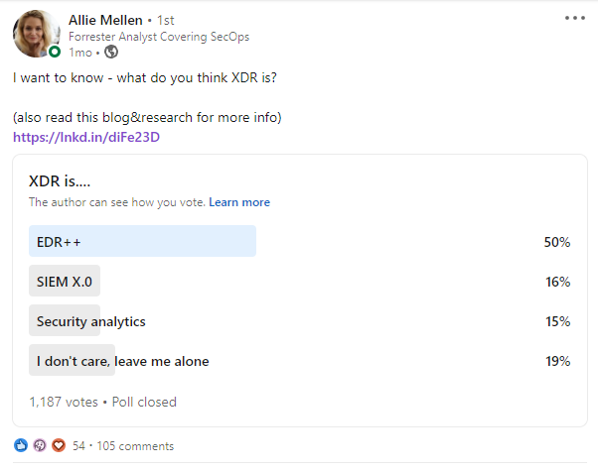
 | Security Analytics Platform | XDR
Architecture | Based on data normalization + analytics | Based on EDR
 | MITRE ATT&CK alignment | MITRE ATT&CK alignment
 | Detections architected on log sources + alerts | Detections architected on high-efficacy telemetry
 | SOAR integrated response via playbooks | Native response and automated recommendations
 | Relies on integrations | Augments existing capabilities with integrations
Outcomes | Investigation via querying and correlating alerts | Investigation via automated RCA and querying
 | Threat hunting via querying | Threat hunting via querying
 | Governance, Risk management, and Compliance
 | Dashboard and reporting
—Forrester Report “What Security Market Definitions Tell Practitioners”, Sept-2021
Notes:
https://go.forrester.com/blogs/xdr-defined-giving-meaning-to-extended-detection-and-response/
XDR Defined: Giving Meaning To Extended Detection And Response - APR 28 2021
https://www.forrester.com/report/Adapt+Or+Die+XDR+Is+On+A+Collision+Course+With+SIEM+And+SOAR/RES165775?objectid=RES165775

Slide 19
In summary …..
XDR fills 03 gaps of SIEM:
Detection: XDR prioritizes the data used for detection
Investigation: automated root cause analysis, larger context
Response: Completely and Quickly. Recommended (maybe automated) actions

Slide 20
Nên lựa chọn giải pháp nào cho doanh nghiệp?

Slide 21

The Security Trade-Off
Improve Security Posture
Prevent data loss
Block attacks
Deny hackers
Reduce IT Costs
Headcount
Opex
Capex
Risk
Investment

Slide 22

Protection
Detection and Response
Do it yourself?
XDR
Product only
Done for you?
MTR
+ Service
During an incident?
+ Service
RR
Rapid Response

Slide 23
Bản quyền tính như thế nào?

Slide 24
Detection & Response Offerings
Protection
Detection & Response
Managed
Service
 |  | Intercept X Advanced | Intercept X Advanced with XDR | MTR Advanced
Management | Multiple Policy Support | ✓ | ✓ | ✓
Automated protection | Foundational techniques | ✓ | ✓ | ✓
 | Deep learning malware detection | ✓ | ✓ | ✓
 | Exploit and anti-ransomware | ✓ | ✓ | ✓
 | Control Features (Web, App, Peripheral, DLP) | ✓ | ✓ | ✓
 | Threat Cases | ✓ | ✓ | ✓
Detection & response | Live Discover and Live Response |  | ✓ | ✓
 | Sophos Data Lake retention |  | 30 days | 30 days
 | On-device data retention |  | 90 days | 90 days
 | Cross-product data sources |  | ✓ | ✓
Managed detection & response | 24/7 monitoring |  |  | ✓
 | Threat hunting |  |  | ✓
 | Incident response |  |  | ✓

